Slide 1
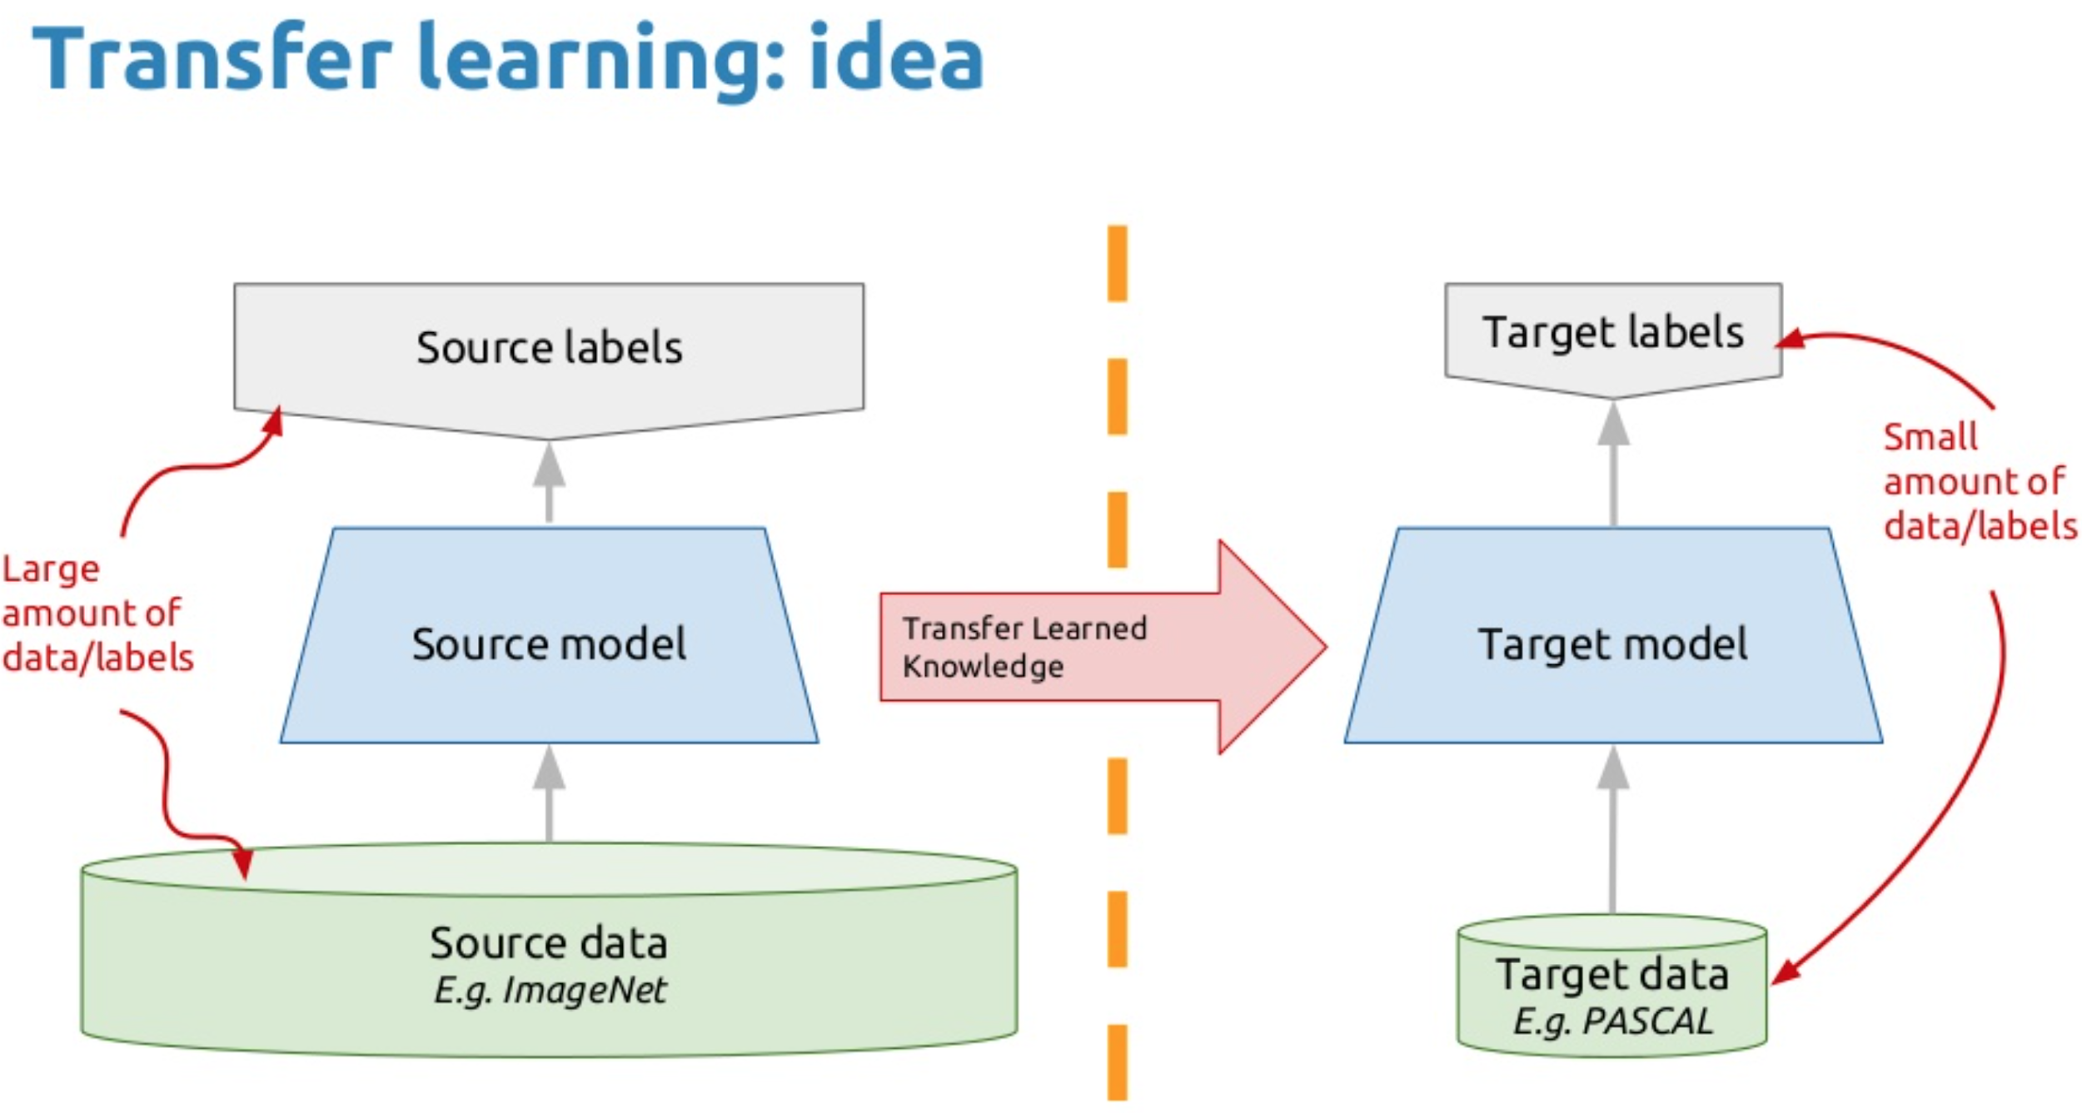
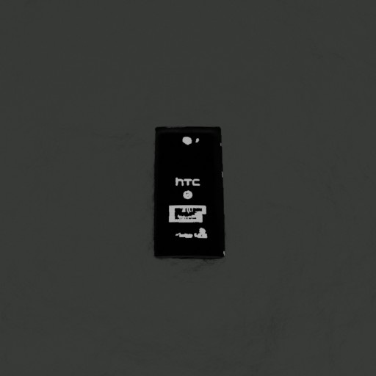
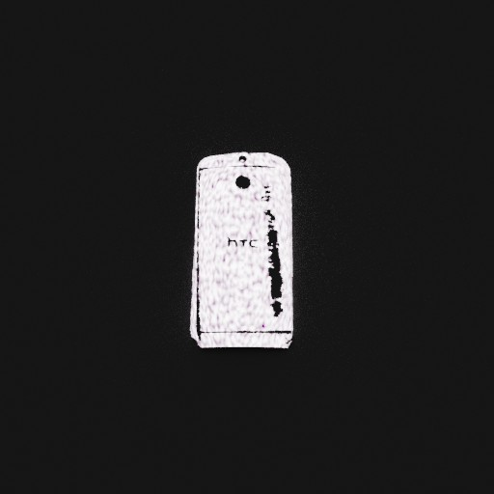
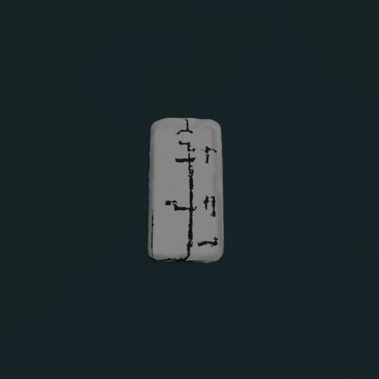
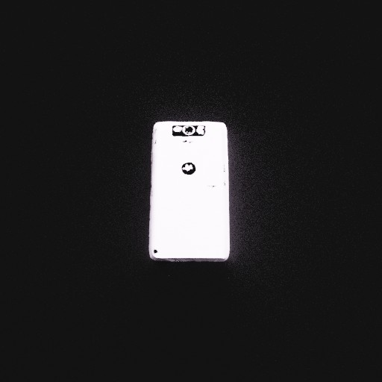
Methods to improve the classification accuracy
Method1
Transfer learning of classification network based on Inceptionv3 model.
Dataset:
Synthetic data generated using domain randomization.

Slide 2
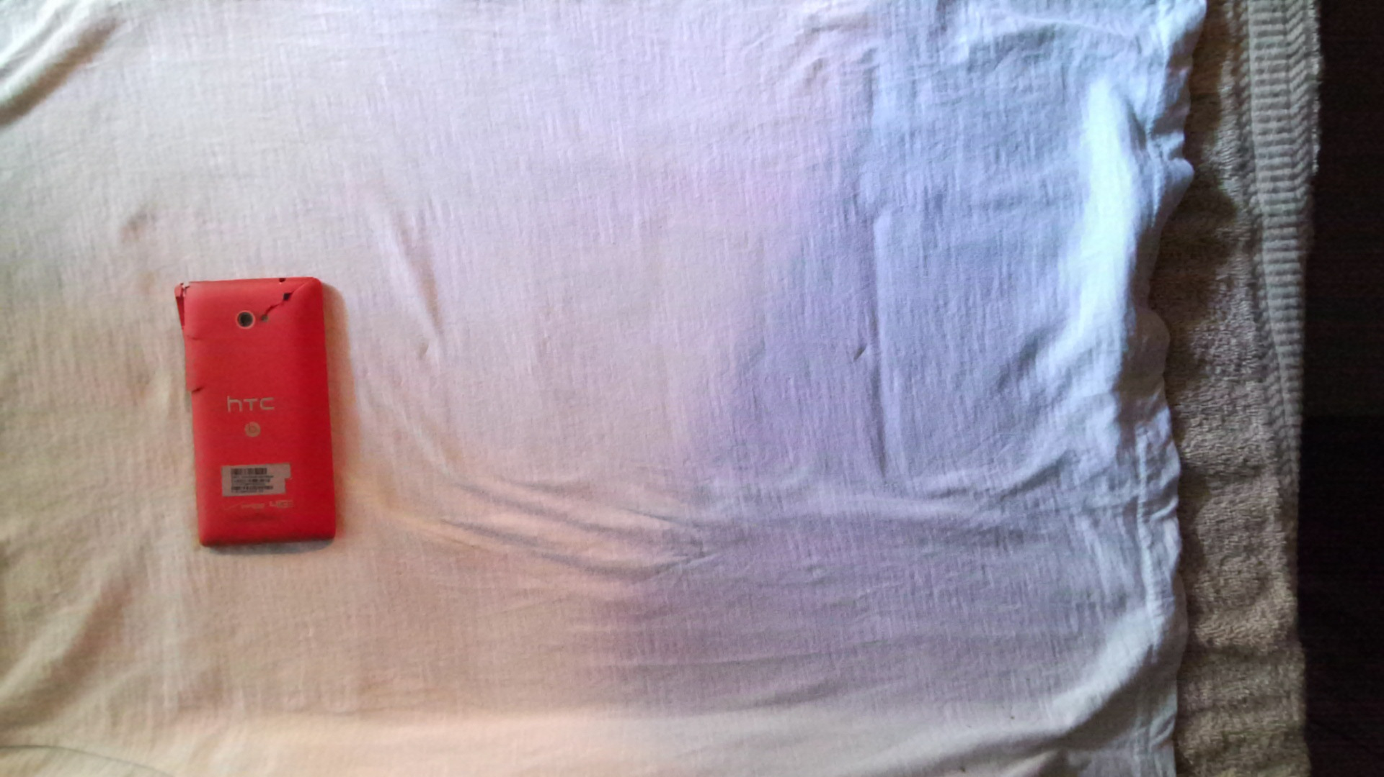
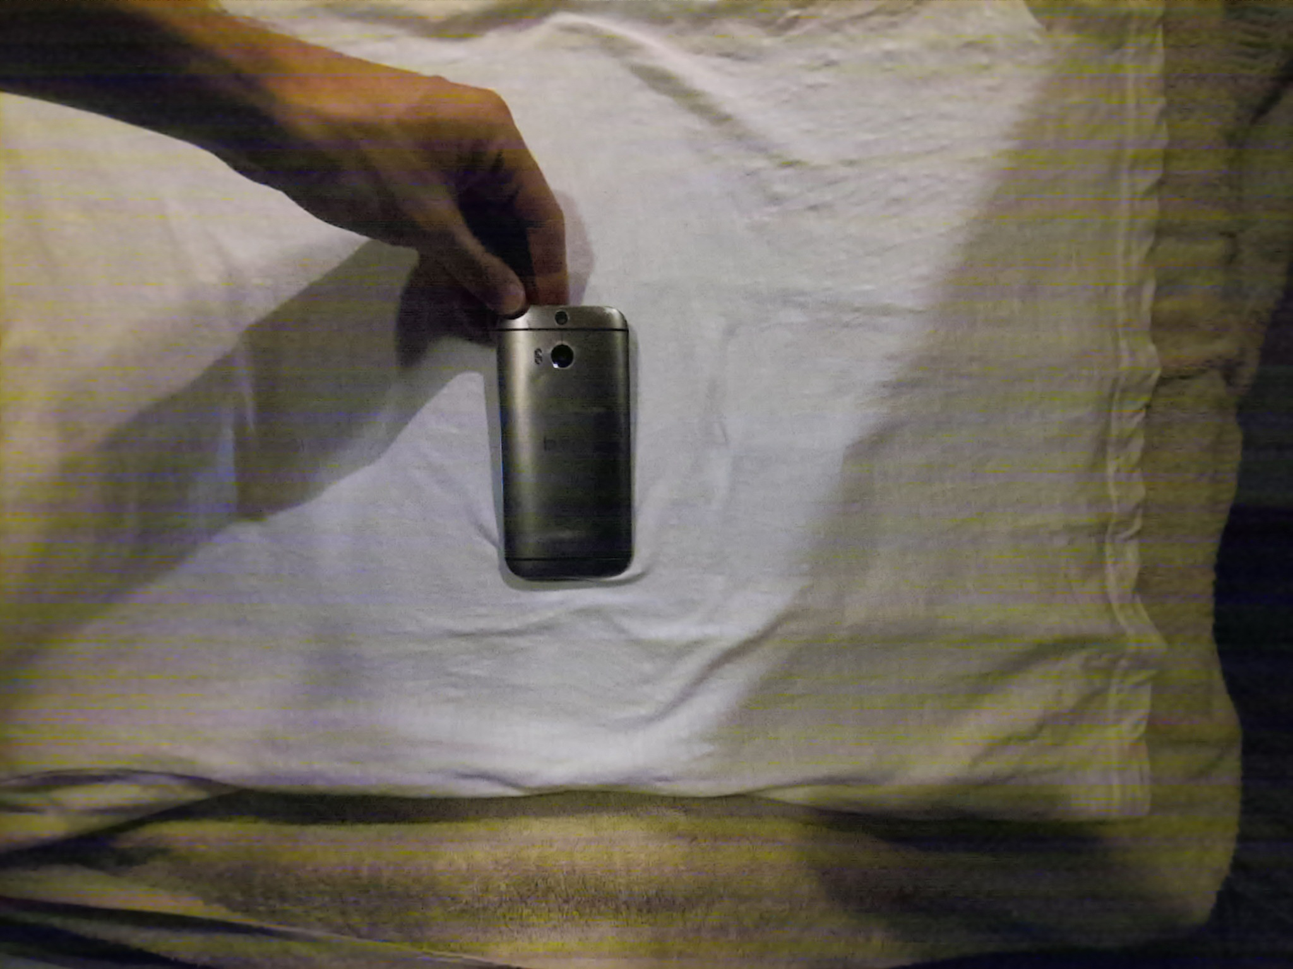
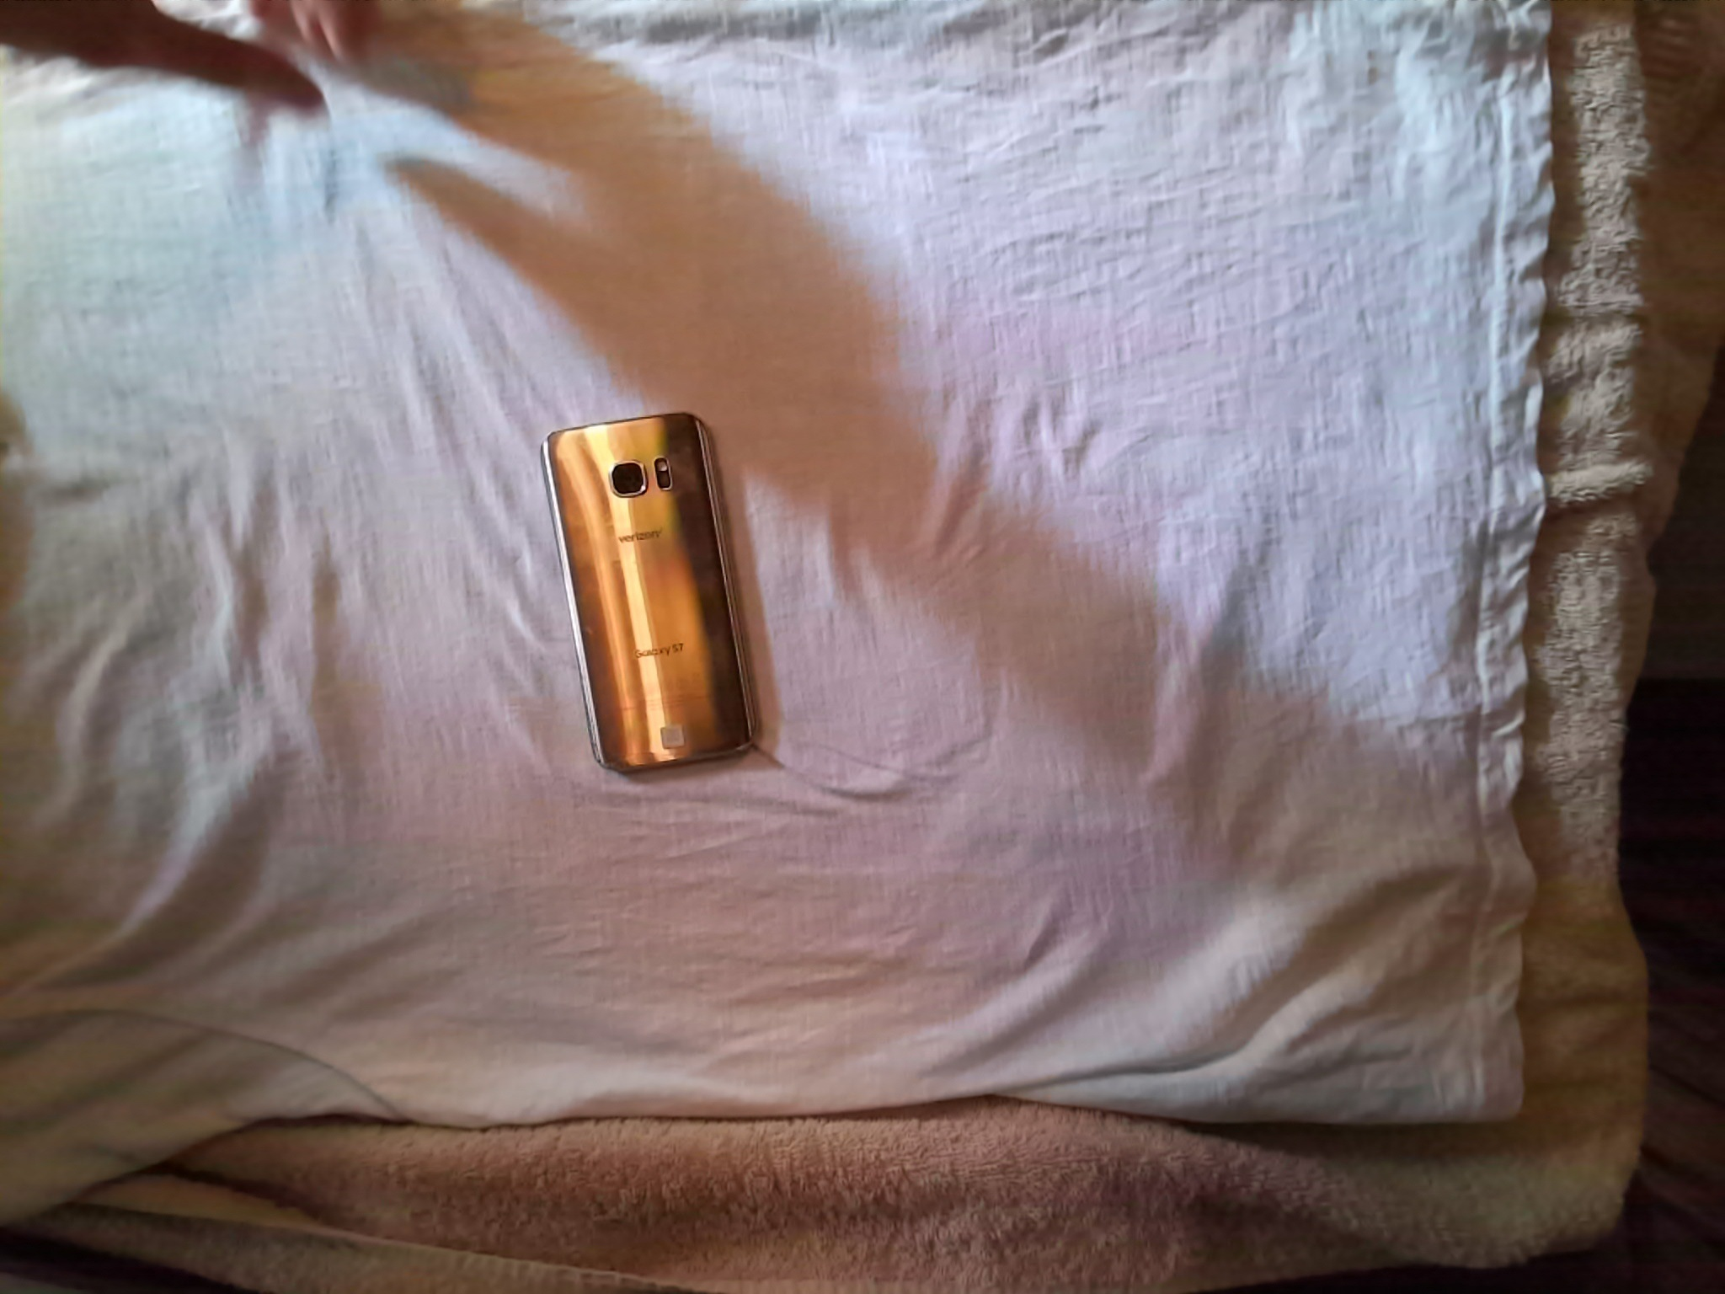
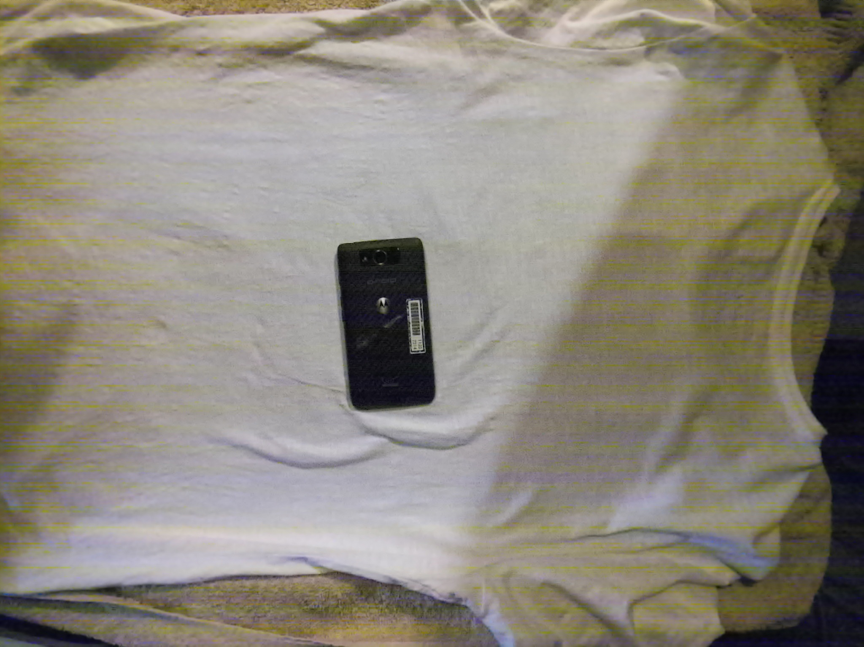
Method2
Dataset
Transfer learning of classification network based on Inceptionv3 model.
Dataset:
Synthetic data generated using domain randomization
and
Single view real phone images

Slide 3
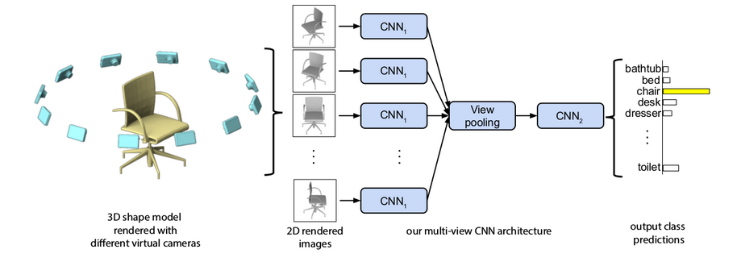
Method3
Classification model trained on multiple views of the same object.
Synthetic data generated using domain randomization
and
Single view real phone images
A fixed set of camera views used for data generation.

Slide 4
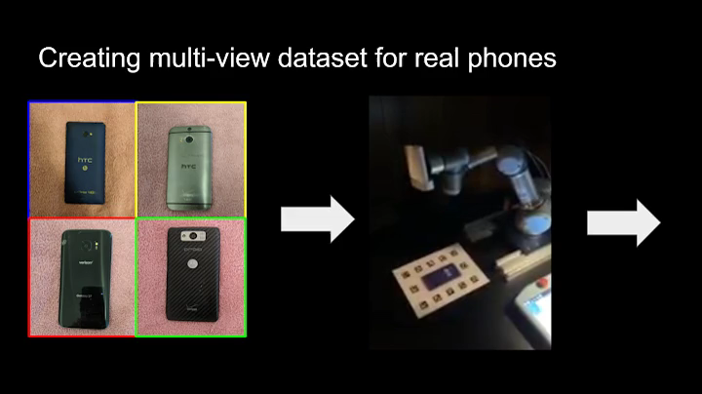
Dataset generation for Method3:

